Slide 1

Loan Approval Prediction System
DATA SCIENCE MINI PROJECT
Submitted by
RAJUMENAN B - 422423104306

Slide 2
Introduction
Loan approval is a critical decision banks make for every applicant, traditionally done manually
Manual review is slow, inconsistent across officers, and can introduce bias
This project builds a data-driven system to predict loan approval automatically
Domains covered: DS (Financial Analytics), ML (Approval Prediction), AI (Credit Evaluation)

Slide 3
Abstract
Analyzed around 4,269 loan applications to understand and predict approval outcomes. Cleaned data, engineered financial ratios, and trained 3 ML models. CIBIL score found to be the dominant driver of approval (~79% importance). Best model (Decision Tree) achieved F1-score = 0.998, ROC-AUC = 0.999. Delivers a reusable model for fast, consistent, automated credit evaluation.

Slide 4
Project Objectives
Clean and prepare the raw loan applicant dataset
Explore which applicant attributes drive approval decisions
Engineer financially meaningful features beyond raw columns
Train and compare multiple ML classification models
Evaluate and select the best-performing model
Translate findings into a usable credit-evaluation workflow

Slide 5
Tools and Technologies Used
Language: Python 3
Environment: Jupyter Notebook / Google Colab
Data handling: pandas, numpy
Visualization: matplotlib, seaborn
Machine Learning: scikit-learn (Logistic Regression, Decision Tree, Random Forest)
Model persistence: joblib
Reporting: Microsoft Word, PowerPoint

Slide 6
Dataset Description
Source: loan_approval_dataset.csv
Size: 4,269 records × 13 features
Type: Structured, static snapshot data
Target: loan_status (Approved / Rejected)
Feature groups: Demographics, Financials, Credit Score, Assets

Slide 7
Data Preprocessing
Verified 0 missing values across all records
Stripped whitespace from column names and categorical text
Fixed records with invalid negative asset values
Label-encoded categorical fields (education, self_employed, loan_status)
Standardized numeric features for Logistic Regression.

Slide 8
Exploratory Data Analysis (EDA)
Analyzed the distribution of loan approval classes for reliable model training
Compared CIBIL score distribution across approval outcomes
Examined income vs. loan amount relationship
Checked correlation between numeric features
Analyzed approval rate by education and self-employment status

Slide 9
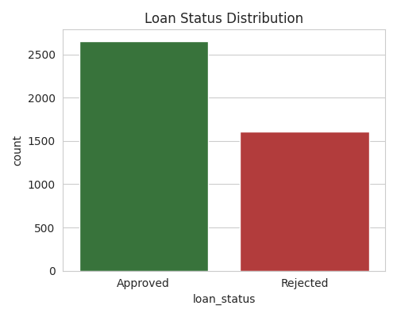
Data Visualization
Bar chart: Loan status distribution

Slide 10
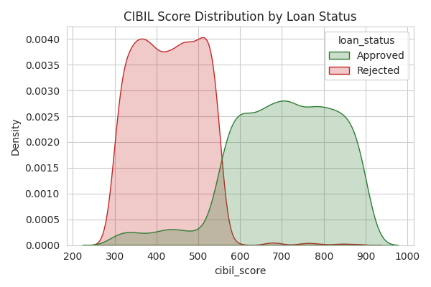
KDE plot: CIBIL score by approval outcome

Slide 11
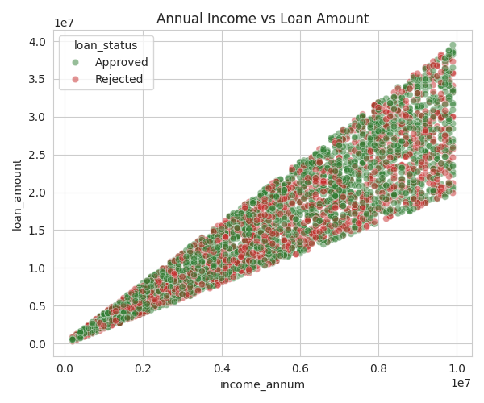
Scatter plot: Income vs. loan amount

Slide 12
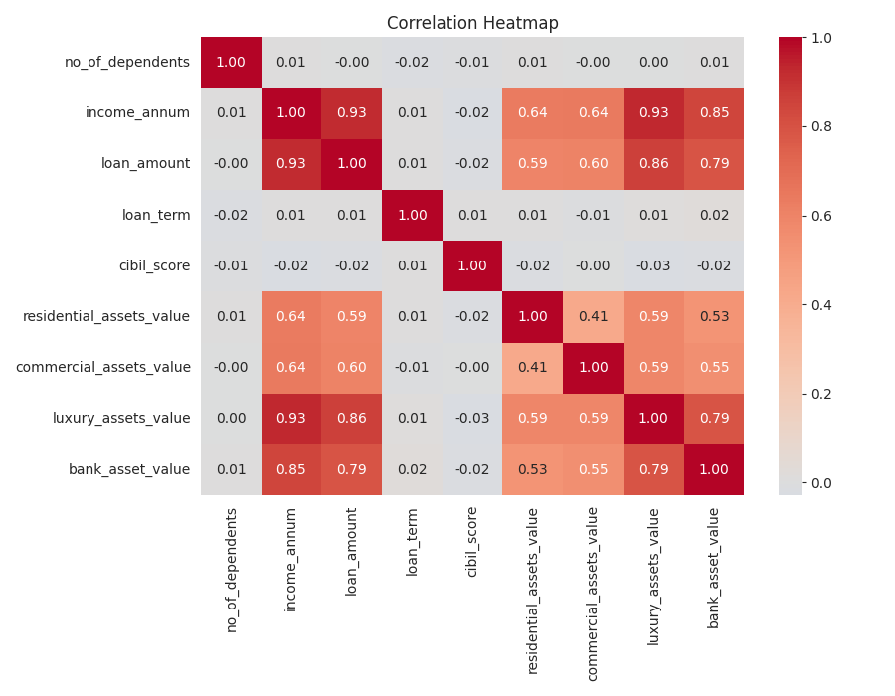
Heatmap: Feature correlation matrix

Slide 13
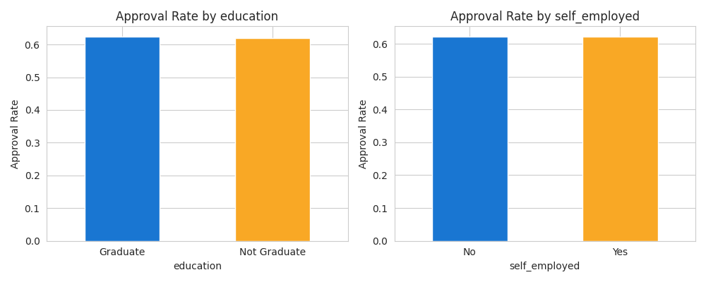
Bar chart: Approval rate by demographic group

Slide 14
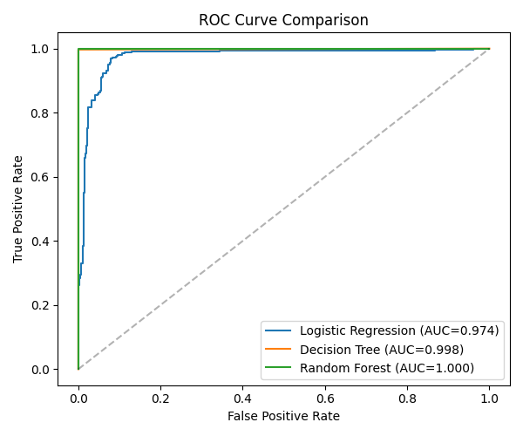
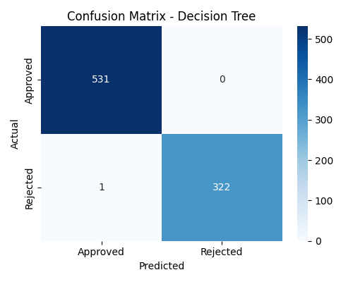
Confusion matrix & ROC curve: Model performance visuals

Slide 15
Results and Insights
CIBIL score is the strongest predictor (~79% feature importance)
Approved applicants average CIBIL ≈900; rejected average ≈650
Education and self-employment have almost no effect on approval
Decision Tree is a “Best model” outperformed Logistic Regression — approval boundary is non-linear
Engineered asset-to-loan ratio added more predictive power than raw asset columns
Model | F1-Score | ROC-AUC
Logistic Regression | 0.886 | 0.975
Decision Tree | 0.998 | 0.999
Random Forest | 0.997 | 1.000

Slide 16
Advantages
Faster loan decisions compared to manual review
Consistent, criteria-based evaluation reduces human bias
Scales easily to thousands of applications
Transparent decision drivers (credit score-based) support explainability
Reusable, deployable model for real-time credit evaluation

Slide 17
Challenges Faced
Handling data quality issues (negative asset values)
Determining the right feature engineering to add real signal
Balancing model interpretability vs. predictive performance
Near-perfect scores raised concerns about dataset realism vs. real-world noise
Selecting the best model among close-performing candidates (Decision Tree vs. Random Forest)

Slide 18
Future Scope
Validate the model on real, noisier bank lending data
Add explainability (SHAP values) for regulatory transparency
Deploy as a live API / web form for real-time credit evaluation
Track loan repayment/default outcomes over time for long-term risk modeling
Integrate with CRM/loan-management systems for automated routing

Slide 19
Conclusion
Successfully built an end-to-end DS → ML → AI pipeline for loan approval prediction
Identified CIBIL score as the dominant factor in lending decisions
Achieved high-accuracy predictions using a Decision Tree model
Delivered a practical foundation for automated, consistent credit evaluation

Slide 20
References
Dataset: loan_approval_dataset.csv (project dataset)
scikit-learn documentation — https://scikit-learn.org
andas documentation — https://pandas.pydata.org
seaborn documentation — https://seaborn.pydata.org
Matplotlib documentation — https://matplotlib.org
Anthropic Claude AI — https://claude.ai

Slide 21
THANK YOU

